Slide 1
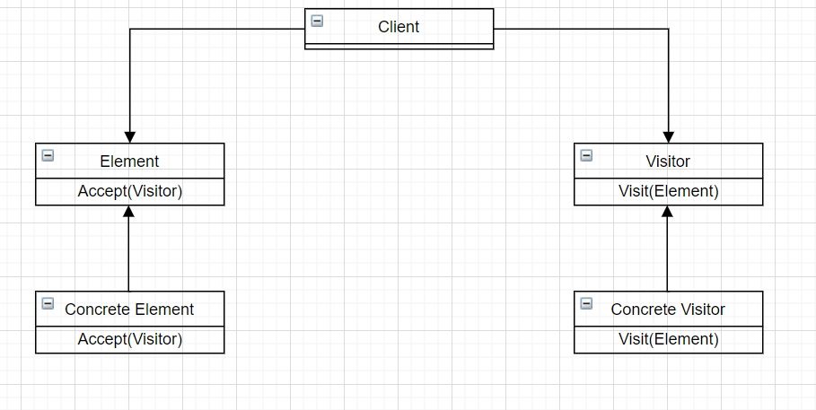
Design Pattern: Visitor
Group 9 – APCS 21 CTT2
Members:
Võ Thanh Phúc – 21125056
Nguyễn Đình Ngọc Trí - 21125065
Nguyễn Minh Vĩ – 21125067
Lê Nguyễn Đăng Khoa - 21125164

Slide 2

What’s inside our presentation?
Content:
Problems and naive solution.
Introduction to Visitor design pattern.
How to solve problem with Visitor.
Pros and cons to our design pattern.
Similar problem.

Slide 3

1. Real-World problem and naive solution
A modern problem that if we use normal-naive solution will cost a lot of efforts, time and may cause some bugs

Slide 4
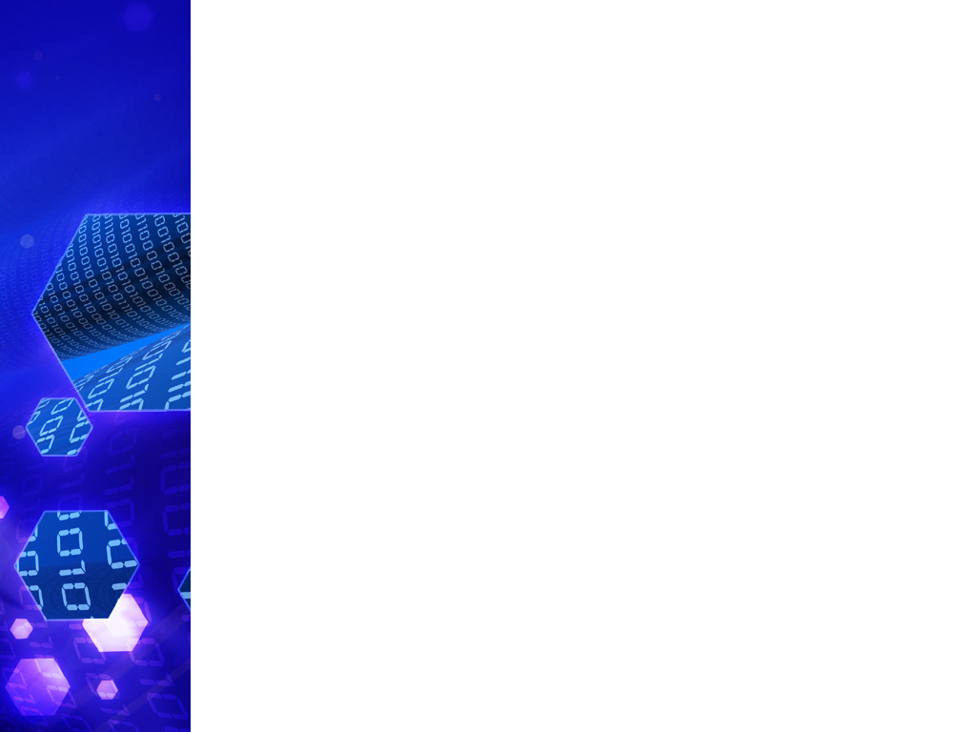
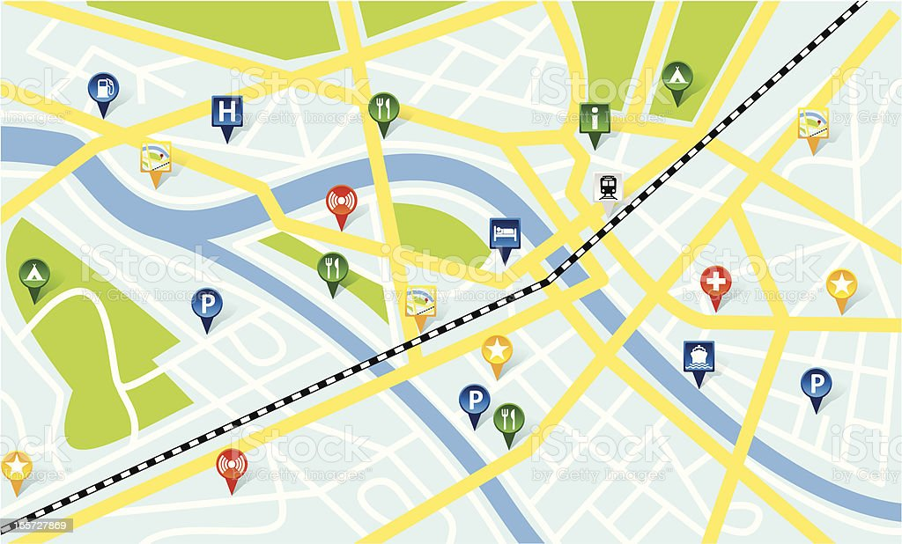
Preview to our Real-world problem
Imagine that you are building an app working with geographic information structured as one colossal graph. Each node of the graph represents a complex entity such as a city, but also more granular things like industries, sightseeing areas, etc. Each node type is represented by its own class, while each specific node is an object.

Slide 5
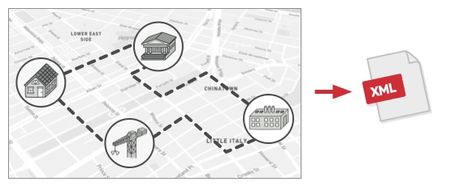
Problem:
From the graph for that city, now , we need to implement to export the graph to XML format.

Slide 6
Naive solution:
You planned to add an export method to each node class and then leverage recursion to go over each node of the graph, executing the export method.
→ This solution was simple.
#include <iostream> using namespace std; class Point { private: int x, y; public: Point() { x = y = 0; } Point(int x, int y) { this->x = x; this->y = y; } void Show() { cout << x << "," << y << endl; } };
Component export

Slide 7
Naive solution:
class Shape { public: virtual void XMLexport() = 0; };
class Circle :public Shape{ private: int ID; Point C; int Radius; public: Circle(){ ID = 2; Radius = 3; } void Show(){ cout << "Circle" << endl; C.Show(); cout << "ID = " << ID << endl; cout << "Radius = " << Radius << endl; } void XMLexport(){ Show(); } };
class Dot : public Shape { private: int ID; Point a; public: Dot() { ID = 1; } void Show() { cout << "Dot" << endl; cout << "ID = " << ID << endl; a.Show(); } void XMLexport() { Show(); } };
Consider each type of building is a different type of shapes, inherited from a class Shape
class Application { private: Shape* arr[4] = { new Dot, new Circle, new Dot, new Circle }; public: void exportXML() { for (int i = 0; i < 4; i++) arr[i]->XMLexport(); } };
Apps Export function
Export function

Slide 8



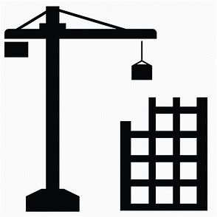
Trouble - Why we shouldn’t use it:
However, the code was already in production and by altering existing node classes, a potential bug in your changes may happens.
Industrial
</>XML Export Implementation
Residential
Existing application’s classses
Commercial
Construction

Slide 9
Trouble - Why we shouldn’t use it:
The XML export method had to be added into all node classes, which bore the risk of breaking the whole application if any bugs slipped through along with the change.
Besides, the primary job of these classes was to work with geodata. If this feature was implemented and your client would ask you to provide the ability to export into another format or request some other weird stuff, this would force you to change those precious and fragile classes again. The solution would then become complicated and cause errors.

Slide 10
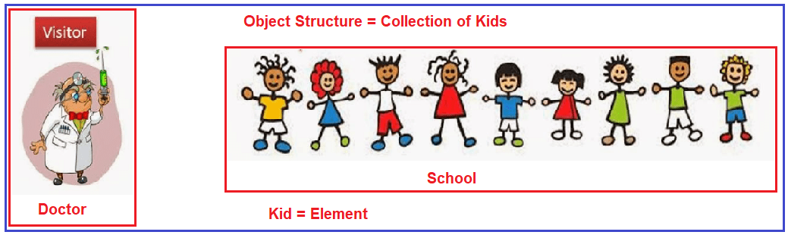
2. An introduction about Visitor pattern

Slide 11
What is Visitor?
Visitor a behavioral design pattern that lets you to define a new operation without changing the class of elements on which the object operates.
So, what is the key idea to understand visitor?

Slide 12
Main idea-Visitor:
The Visitor pattern suggests that you place the new behavior into a separate class called visitor, instead of trying to integrate it into existing classes. The original object that had to perform the behavior is now passed to one of the visitor’s methods as an argument, providing the method access to all necessary data contained within the object.

Slide 13
Technique - Property
The Visitor pattern uses a technique called Double Dispatch, which helps to execute the proper method on an object without cumbersome conditionals. Instead of letting the client select a proper version of the method to call, we delegate this choice to objects we’re passing to the visitor as an argument. Since the objects know their own classes, they’ll be able to pick a proper method on the visitor.
→ Fact: We can say they “accept” a visitor and tell it what visiting method should be executed.

Slide 14
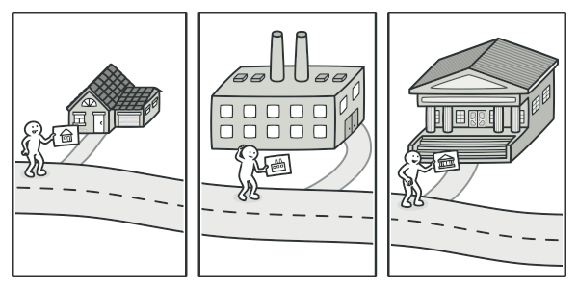
Illustration
A good insurance agent is always ready to offer different policies to various types of organizations.

Slide 15
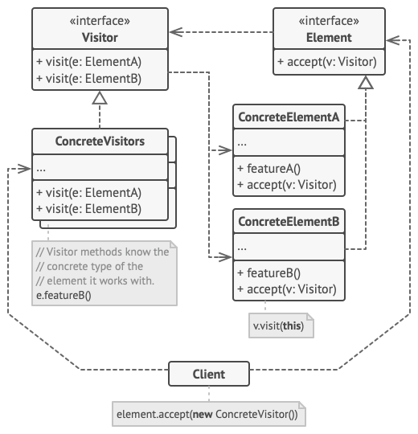
General Class Diagram - Explanation
The Visitor interface declares a set of visiting methods that can take concrete elements of an object structure as arguments. These methods may have the same names if the program is written in a language that supports overloading, but the type of their parameters must be different.
Each Concrete Element must implement the acceptance method. The purpose of this method is to redirect the call to the proper visitor’s method corresponding to the current element class. Be aware that even if a base element class implements this method, all subclasses must still override this method in their own classes and call the appropriate method on the visitor object.
The Element interface declares a method for “accepting” visitors. This method should have one parameter declared with the type of the visitor interface.
Each Concrete Visitor implements several versions of the same behaviors, tailored for different concrete element classes.

Slide 16
General Class Diagram - Explanation
The Client usually represents a collection or some other complex object (for example, a Composite tree). Usually, clients aren’t aware of all the concrete element classes because they work with objects from that collection via some abstract interface.

Slide 17
NOW, LET’S COMEBACK TO OUR MAIN PROBLEM.
Check out class diagram for solution to our problem.

Slide 18
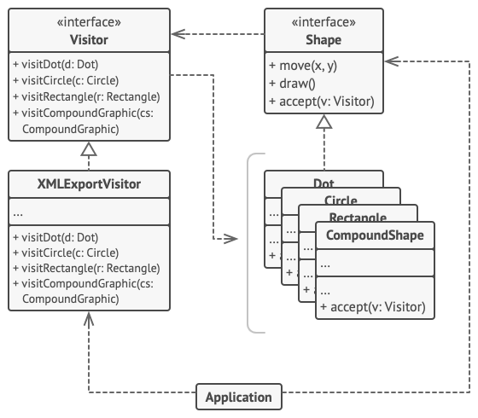
Class diagram for problem
The Visitor pattern adds XML export support to the class hierarchy of geometric shapes.

Slide 19
Explain on class diagram:
Shape is equivalent to Element in the diagram, and the list of Shape equivalent to Concrete Element. The application is the Client we’re looking for.

Slide 20

implementation for visitor in this problem

Slide 21
Elementary prepare
class Visitor; class Point { private: int x, y; public: Point() { x = y = 0; } Point(int x, int y) { this->x = x; this->y = y; } void Show(){ cout << x << "," << y << endl; } };
Declare class Visitor first
Component export

Slide 22
Base class: Shape
class Shape { public: virtual void accept(Visitor* v) = 0; };
Virtual accept function for other derived class for visitor come in.

Slide 23
Concrete Element Class:
class Dot : public Shape { private: int ID; Point a; public: Dot() { ID = 1; } void accept(Visitor* v); void Show() { cout << "Dot" << endl; cout << "ID = " << ID << endl; a.Show(); } };
Each Element class has its own property, behavior and attribute, but the accept function for Visitor we will discuss later

Slide 24
Concrete Element Class:
class Circle :public Shape{ private: int ID; Point C; int Radius; public: Circle(){ ID = 2; Radius = 3;
} void accept(Visitor* v); void Show(){ cout << "Circle" << endl; C.Show(); cout << "ID = " << ID << endl; cout << "Radius = " << Radius << endl; } };
Each Element class has its own property, behavior and attribute, but the accept function for Visitor we will discuss later

Slide 25
Concrete Element Class:
class CompoundShape :public Shape { private: int ID; public: CompoundShape() { ID = 3; } void accept(Visitor* v); void Show() { cout << "Compound Shape" << endl; cout << "ID = " << ID << endl; } };
Each Element class has its own property, behavior and attribute, but the accept function for Visitor we will discuss later

Slide 26
Concrete Element Class:
class Rectangle :public Shape{ private: int ID ,wi, he; Point tl; public: Rectangle(){ ID = 4; wi = 1; he = 2; } void accept(Visitor* v); void Show(){ cout << "Rectangle" << endl; cout << "Rectangle's ID = " << ID << endl; cout << "Rectangle's tl coordinate = "; tl.Show(); cout << "Rectangle's width = " << wi << endl; cout << "Rectangle's height = " << he << endl; } };
Each Element class has its own property, behavior and attribute, but the accept function for Visitor we will discuss later

Slide 27
Visitor Class
class Visitor { public: virtual void visitDot(Dot* d) = 0; virtual void visitCircle(Circle* cir) = 0; virtual void visitRectangle(Rectangle* rec) = 0; virtual void visitCompoundShape(CompoundShape* cpsh) = 0; };
We define Visitor class is a class include virtual function to visit each type of concrete element.

Slide 28
Accept Visitor in Each Concrete Element class
void Dot::accept(Visitor* v) { v->visitDot(this); } void Rectangle::accept(Visitor* v) { v->visitRectangle(this); } void Circle::accept(Visitor* v) { v->visitCircle(this); } void CompoundShape::accept(Visitor* v) { v->visitCompoundShape(this); }
Each accept function allow Visitor visit each concrete Element in the problem

Slide 29
Exporting by Visitor ( Key for the problem)
class XMLExportVisitor : public Visitor { public: void visitDot(Dot* d){ d->Show(); } void visitCircle(Circle* cir){ cir->Show(); } void visitRectangle(Rectangle* rec){ rec->Show(); } void visitCompoundShape(CompoundShape* cpsh){ cpsh->Show(); } };

Slide 30
Key idea for Visitor implementation
Declare the visitor interface with a set of “visiting” methods, one per each concrete element class that exists in the program.
Declare the element interface. If you’re working with an existing element class hierarchy, add the abstract “acceptance” method to the base class of the hierarchy. This method should accept a visitor object as an argument.
Implement the acceptance methods in all concrete element classes. These methods must simply redirect the call to a visiting method on the incoming visitor object which matches the class of the current element.

Slide 31
Key idea for Visitor implementation
5. For each behavior that can’t be implemented inside the element hierarchy, create a new concrete visitor class and implement all of the visiting methods.
You might encounter a situation where the visitor will need access to some private members of the element class. In this case, you can either make these fields or methods public, violating the element’s encapsulation, or nest the visitor class in the element class. The latter is only possible if you’re lucky to work with a programming language that supports nested classes.
6. The client must create visitor objects and pass them into elements via “acceptance” methods.
4. The element classes should only work with visitors via the visitor interface. Visitors, however, must be aware of all concrete element classes, referenced as parameter types of the visiting methods.

Slide 32


Pros And Cons to
Our Pattern-Visitor

Slide 33

Pros:
Open/Closed Principle. You can introduce a new behavior that can work with objects of different classes without changing these classes.
Single Responsibility Principle. You can move multiple versions of the same behavior into the same class.
A visitor object can accumulate some useful information while working with various objects. This might be handy when you want to traverse some complex object structure, such as an object tree, and apply the visitor to each object of this structure.

Slide 34

Cons:
You need to update all visitors each time a class gets added to or removed from the element hierarchy.
Visitors might lack the necessary access to the private fields and methods of the elements that they’re supposed to work with.

Slide 35

OTHER REAL-WORLD
PROBLEM-APPLICATION

Slide 36
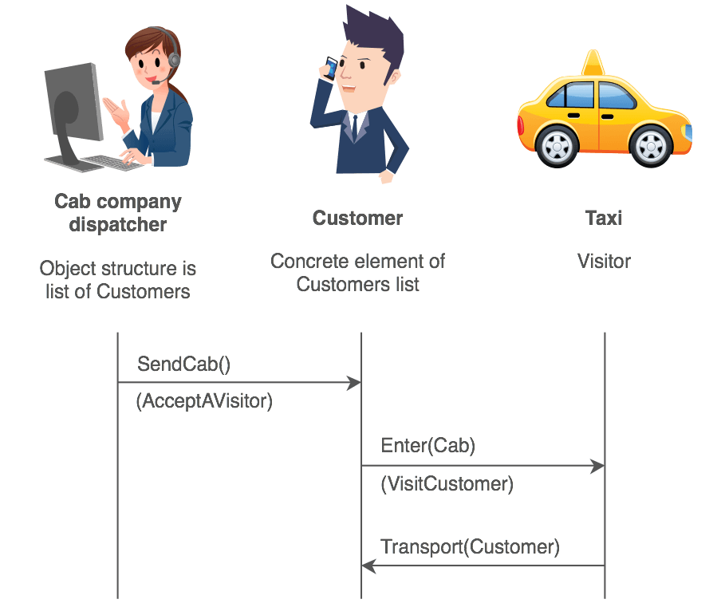
Real-world problem
The Visitor pattern can be observed in the operation of a taxi company. When a person calls a taxi company (accepting a visitor), the company dispatches a cab to the customer. Upon entering the taxi the customer, or Visitor, is no longer in control of his or her own transportation, the taxi (driver) is.

Slide 37

Applicability
Use the Visitor when you need to perform an operation on all elements of a complex object structure (for example, an object tree).
Use the Visitor to clean up the business logic of auxiliary behaviors.
Use the pattern when a behavior makes sense only in some classes of a class hierarchy, but not in others.

Slide 38
Quiz: Question 1:
What category does Visitor belong to?
A. Creational patterns | B. Structural patterns
C. Behavioral patterns | D. None of these.
Answer: C

Slide 39
Quiz: Question 2:
What technique does Visitor use?
A. Double Dispatch | B. Single Dispatch
C. Multiple Dispatch | D. None of these.
Answer: A

Slide 40
Quiz: Question 3:
In Visitor interface, the type of the visiting methods’ parameters:
A. Must be the same | B. Must be different
C. Could be different | D. Depend.
Answer: B

Slide 41
Reference:
Visitor https://refactoring.guru/design-patterns/visitor
Visitor in C++ / Design Patterns
Tổng quan về Visitor Design Pattern
Design Patterns : Elements of Reusable Object-Oriented Software (pg. 366)
#35 Visitor Design Pattern - Behavioural Patterns |DP| - YouTube

Slide 42

THANKS FOR WATCHING
OUR PRESENTATION

